Slide 1
MICROCONTROLLERS AND EMBEDDED SYSTEMS 20XC32
STRINGS,PROCEDURES AND MACROS

Slide 2
The 8086 String instructions
A string is the series of bytes stored in successive memory locations.
Word processor or text editor programs can be used to create strings.
These programs have facility to search through the text.

Slide 3
Moving a String(contd.)
Definition:
You have a string of ASCII characters in successive memory locations in data segment, and you want to move the string to some new location in the data segment.
Basic pseudo code:
REPEAT
MOVE BYTE FROM SOURCE STRING
TO DESTINATION STRING
UNTIL ALL BYTES MOVED

Slide 4
Moving a String(contd.)
The basic pseudo code doesn’t help much in understanding how the algorithm will be implemented.
Expanded code:
INITIALIZE SOURCE POINTER, SI
INITIALIZE DESTINATION POINTER, DI
INITIALIZE COUNTER, CX
REPEAT
COPY BYTE FROM SOURCE TO DESTINATION
INCREMENT SOURCE POINTER
INCREMENT DESTINATION POINTER
DECREMENT COUNTER
UNTIL COUNTER=0

Slide 5
Using compare string byte to check password(contd.)
Definition:
We want to compare a user entered password to the correct password stored in the memory. If the passwords do not match we want to sound an alarm and If the passwords matches we will allow access to computer for that user.
Need:
REPEAT-UNTIL
Compare String instruction CMPS

Slide 6
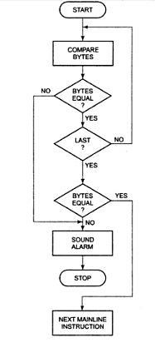
Using compare string byte to check password-flowchart →

Slide 7
Using compare string byte to check password - Code
INITIALIZE PORT DEVICE FOR OUTPUT
INTIALIZE SOURCE POINTER-SI
INITALIZE DESTINATION POINTER-DI
INITIALIZE COUNTER-CX
REPEAT
COMPARE SOURCE BYTE WITH DESTINATION BYTE
INCREMENT SOURCE POINTER
INCREMENT DESTINATION POINTER
DECREMENT COUNTER
UNTIL (STRING BYTES NOT EQUAL) OR (CX=0)
IF STRING BYTES NOT EQUAL THEN
SOUND ALARM
STOP
ELSE DO NEXT MAINLINE INSTRUCTION

Slide 8
The CALL and RET instructions(contd.)
The CALL Instruction:
Stores the address of the next instruction to be executed after the CALL instruction to stack. This address is called as the return address.
Then it changes the content of the instruction pointer register and in some cases the content of the code segment register is set to contain the starting address of the procedure.

Slide 9
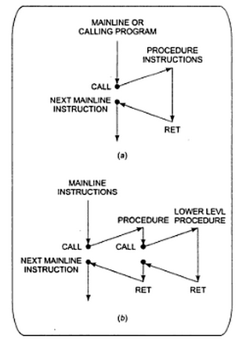
The CALL and RET instructions(contd.)
Chart for CALL and RET instruction →

Slide 10
The CALL and RET instructions
The 8086 RET instruction:
When 8086 does near call it saves the instruction pointer value after the CALL instruction on to the stack.
RET at the end of the procedure copies this value from stack back to the instruction pointer (IP).

Slide 11
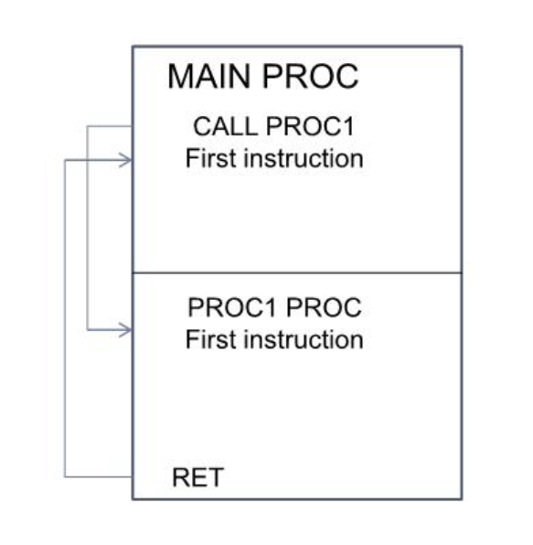

Slide 12
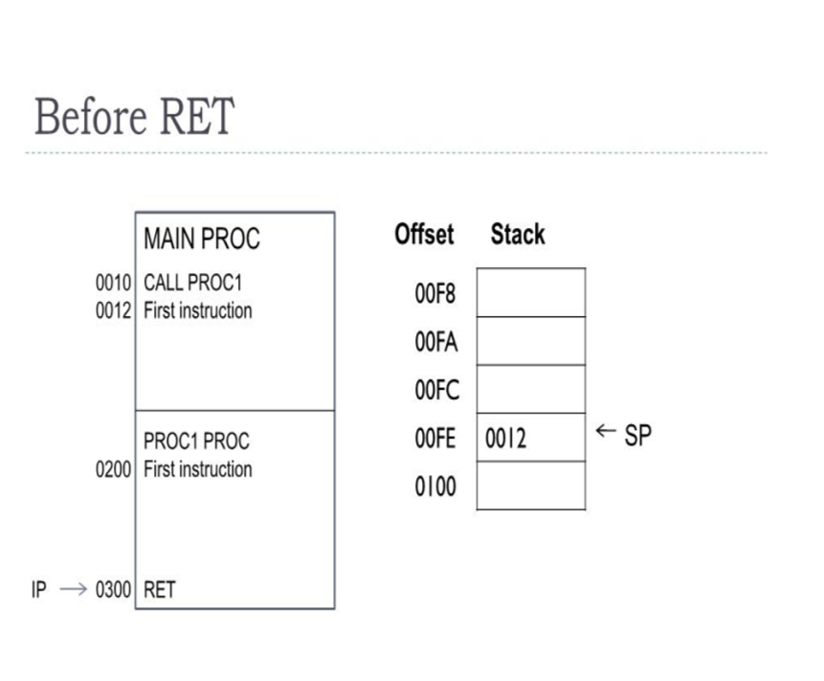
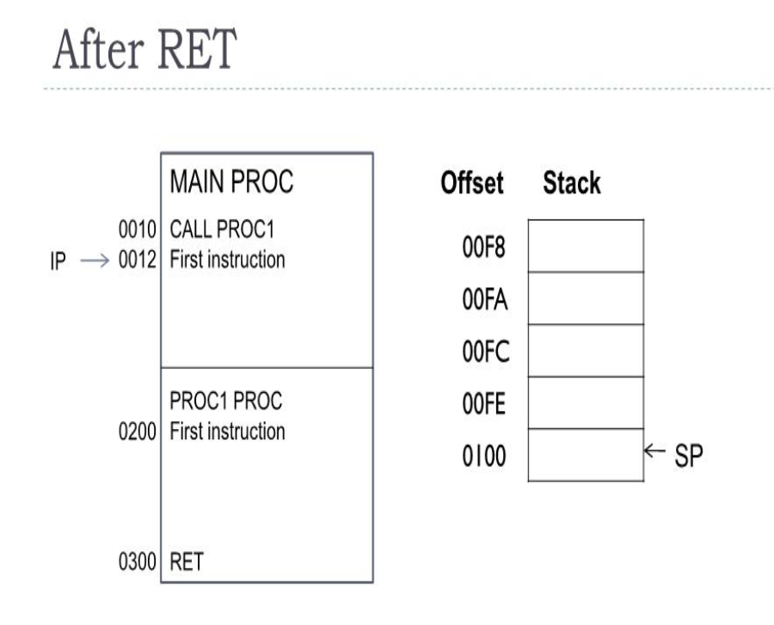

Slide 14
Types of CALL instructions
• NEAR CALL: produce the starting address of the procedure by adding a 16-bit signed displacement to the contents of the instruction pointer.(WITHIN-SEGMENT)
• FAR CALL: used when the called procedure is in different segment.(INTERSEGMENT)

Slide 15
Difference between NEAR and Far
NEAR
FAR
Within Same CS
Replace old IP with new IP
Value of IP is Pushed on the stack
Also called as Intrasegment call
Within Different CS
Replace old pair CS:IP with new pair
Value of pair CS:IP is Pushed on the stack
Also called as Intersegment call

Slide 16
The CALL and RET instructions(contd.)
Types of CALL instructions:
DIRECT WITHIN-SEGMENT NEAR CALL: produce the starting address of the procedure by adding a 16-bit signed displacement to the contents of the instruction pointer.
INDIRECT WITHIN-SEGMENT NEAR CALL: the instruction pointer is replaced with the 16-bit value stored in the register or memory location.
THE DIRECT INTERSEGMENT FAR CALL: used when the called procedure is in different segment. The new value of the instruction pointer is written as bytes 2 and 3 of the instruction code. The low byte of the new IP value is written before the high byte.
THE INDIRECT INTERSEGMENT FAR CALL: replaces the instruction pointer and the contents of the segment register with the two 16-bit values from the memory.

Slide 17
Using PUSH and POP
The PUSH register/memory instruction decrements the stack pointer by 2 and copies the contents of the specified 16-bit register or memory location to memory at the new top-of-stack location.
The POP register/memory instruction copies the word on the top-of-stack to the specified 16-bit register or memory location and increments the stack pointer by 2.

Slide 18
Writing and debugging programs containing procedures
Carefully workout the overall structure of the program and break it down into modules which can easily be written as procedures.
Simulate each procedure with few instructions which simply pass test values to the mainline program. This is called as dummy or stubs.
Check that number of PUSH and POP operations are same.
Use breakpoints before CALL, RET and start of the program or any key points in the program.

Slide 19
Reentrant and Recursive procedures
Reentrant procedures: The procedure which can be interrupted, used and “reentered” without losing or writing over anything.
Recursive procedure: It is the procedure which call itself.

Slide 20
Passing parameters to and from procedures
Major ways of passing parameters to and from a procedure:
In register
In dedicated memory locations accessed by name
With pointers passed in registers
With the stack

Slide 21
Passing Parameter to procedure and from procedure
There are four major ways of passing parameters to and from a procedure.
1) In register
2) In dedicated memory locations accessed by name
3) With pointer passed in register.
4) With the stack

Slide 22
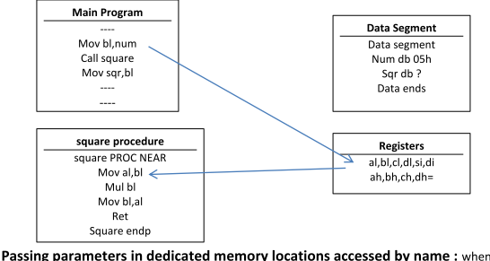
1) Passing parameters in registers
The main program can pass upto 6 parameters to the procedure through the registers AX,BX,CX,DX,SI & DI before executing the call instruction.
e.g. consider the program to calculate a square of given number.

Slide 23
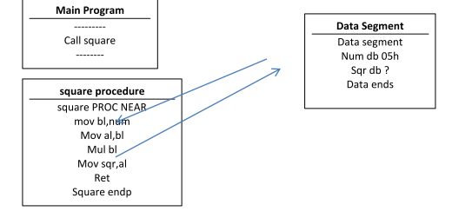
Passing parameters in dedicated memory locations accessed by name
when large number of parameters is to be passed to the procedure, then these parameters can be placed in an argument list as dedicated memory locations in one of the data segment from memory.
e.g. consider the program to calculate a square of given number.

Slide 24
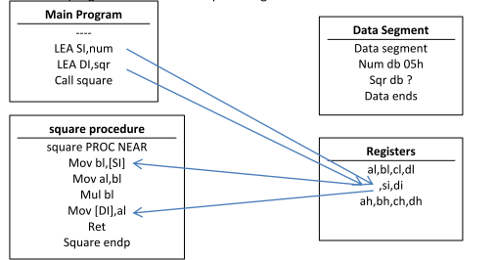
Passing parameters with Pointer
In the main program, before we call the procedure we can set up SI as a pointer to pass values to procedures and set DI as pointer to receive values from procedures.
e.g. consider the program to calculate a square of given number.

Slide 25
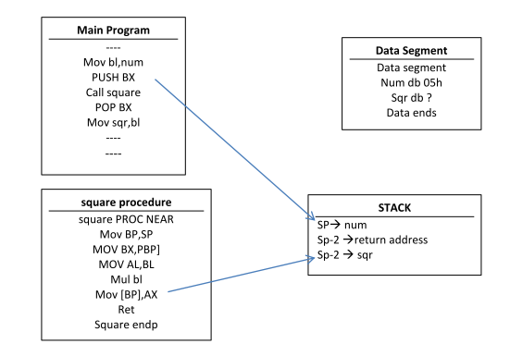
Passing parameters with stack :
Alternate method of passing large number of parameters is to push the parameters on the stack in the main program before we call the procedure.
e.g. consider the program to calculate a square of given number

Slide 26
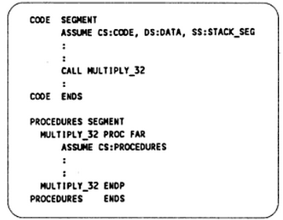
Writing and Calling Far procedures
It is the procedure that is located in a segment which has different name from the segment containing the CALL instruction.

Slide 27
Accessing Procedure in another segment
Accessing a procedure in another segment
Put mainline program in one segment and all the procedures in different segment.
Using FAR calls the procedures can accessed as discuss above.
Accessing procedure and data in separate assembly module
Divide the program in the series of module.
The object code files of each module can be linked together.
In the module where variables or procedures are declared, you must use PUBLIC directive to let the linker know that it can be accessed from other modules.
In a module which calls procedure or accesses a variable in another module, you must use the EXTERN directive.

Slide 28
Writing and using Assembler Macros

Slide 29
Comparison Macros and Procedures
A big advantage of using procedures is that the machine codes for the group of instruction in the procedures needs to be loaded in to main memory only once.
Disadvantage using the procedures is the need for the stack.
A macro is the group of instruction we bracket and give a name to at the start of the program.
Using macro avoids the overhead time involved in calling and returning from a procedures.
Disadvantage is that this will make the program take up more memory than using a procedure.

Slide 30
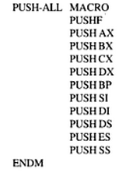
Defining and calling a Macro without parameters

Slide 31
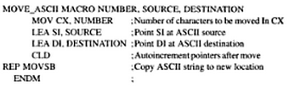
Passing parameters to Macros
The words NUMBER, SOURCE and DESTINATION are called as the dummy variables. When we call the macro, values from the calling statements will be put in the instruction in place of the dummies.

